Slide 1

CONCEPTS OF PROGRAMMING LANGUAGES
12th Edition
Chapter 4
Lexical and Syntax
Analysis

Slide 2
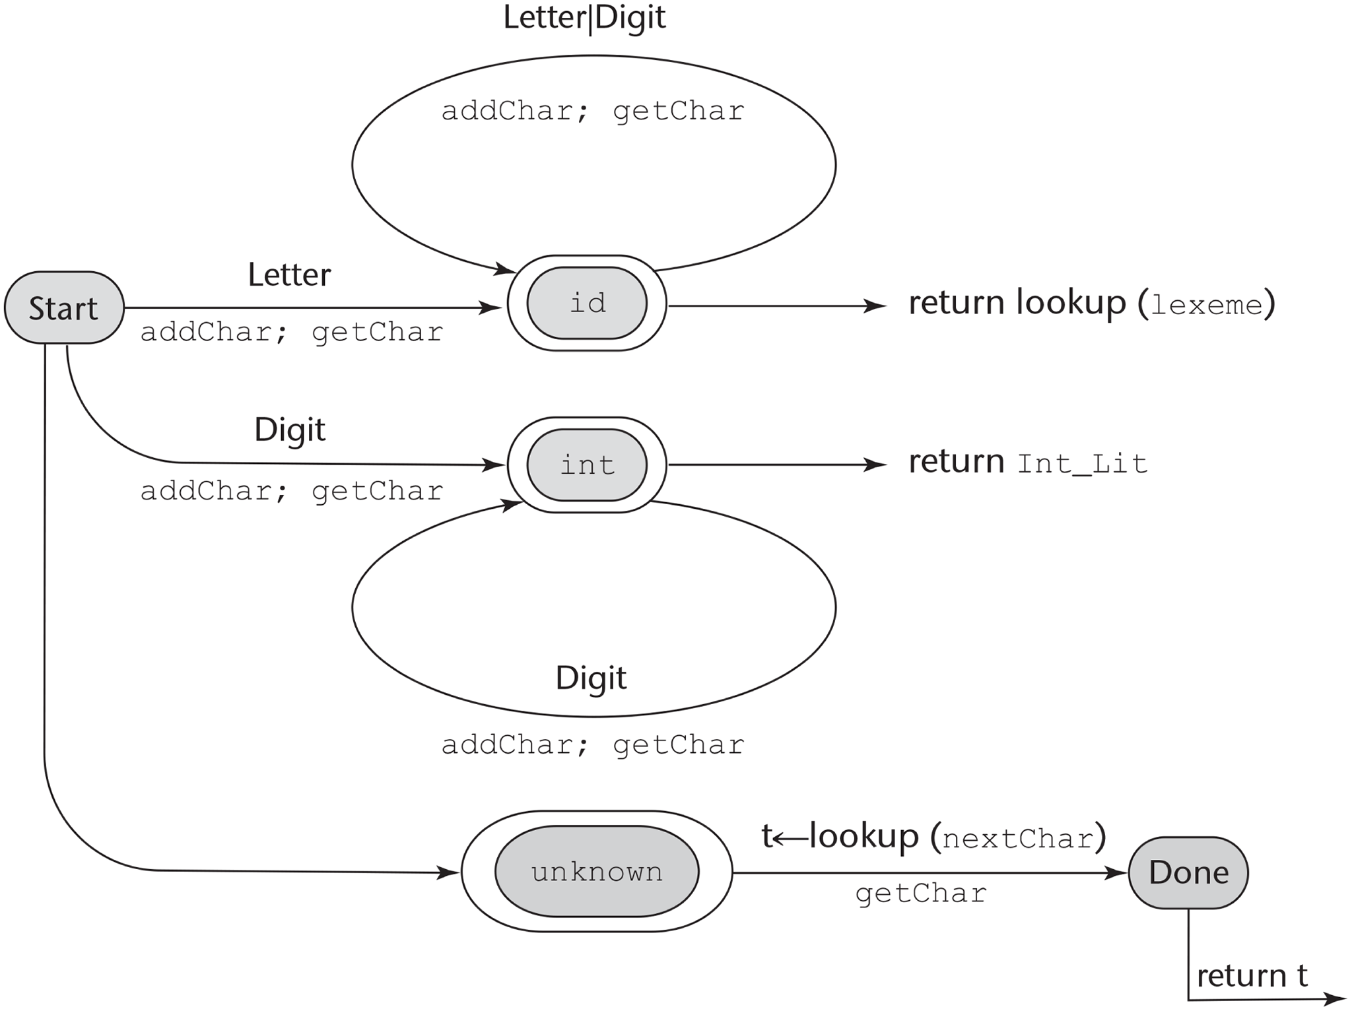
Figure 4-1 A state diagram to recognize names, parentheses, and arithmetic operators

Slide 3
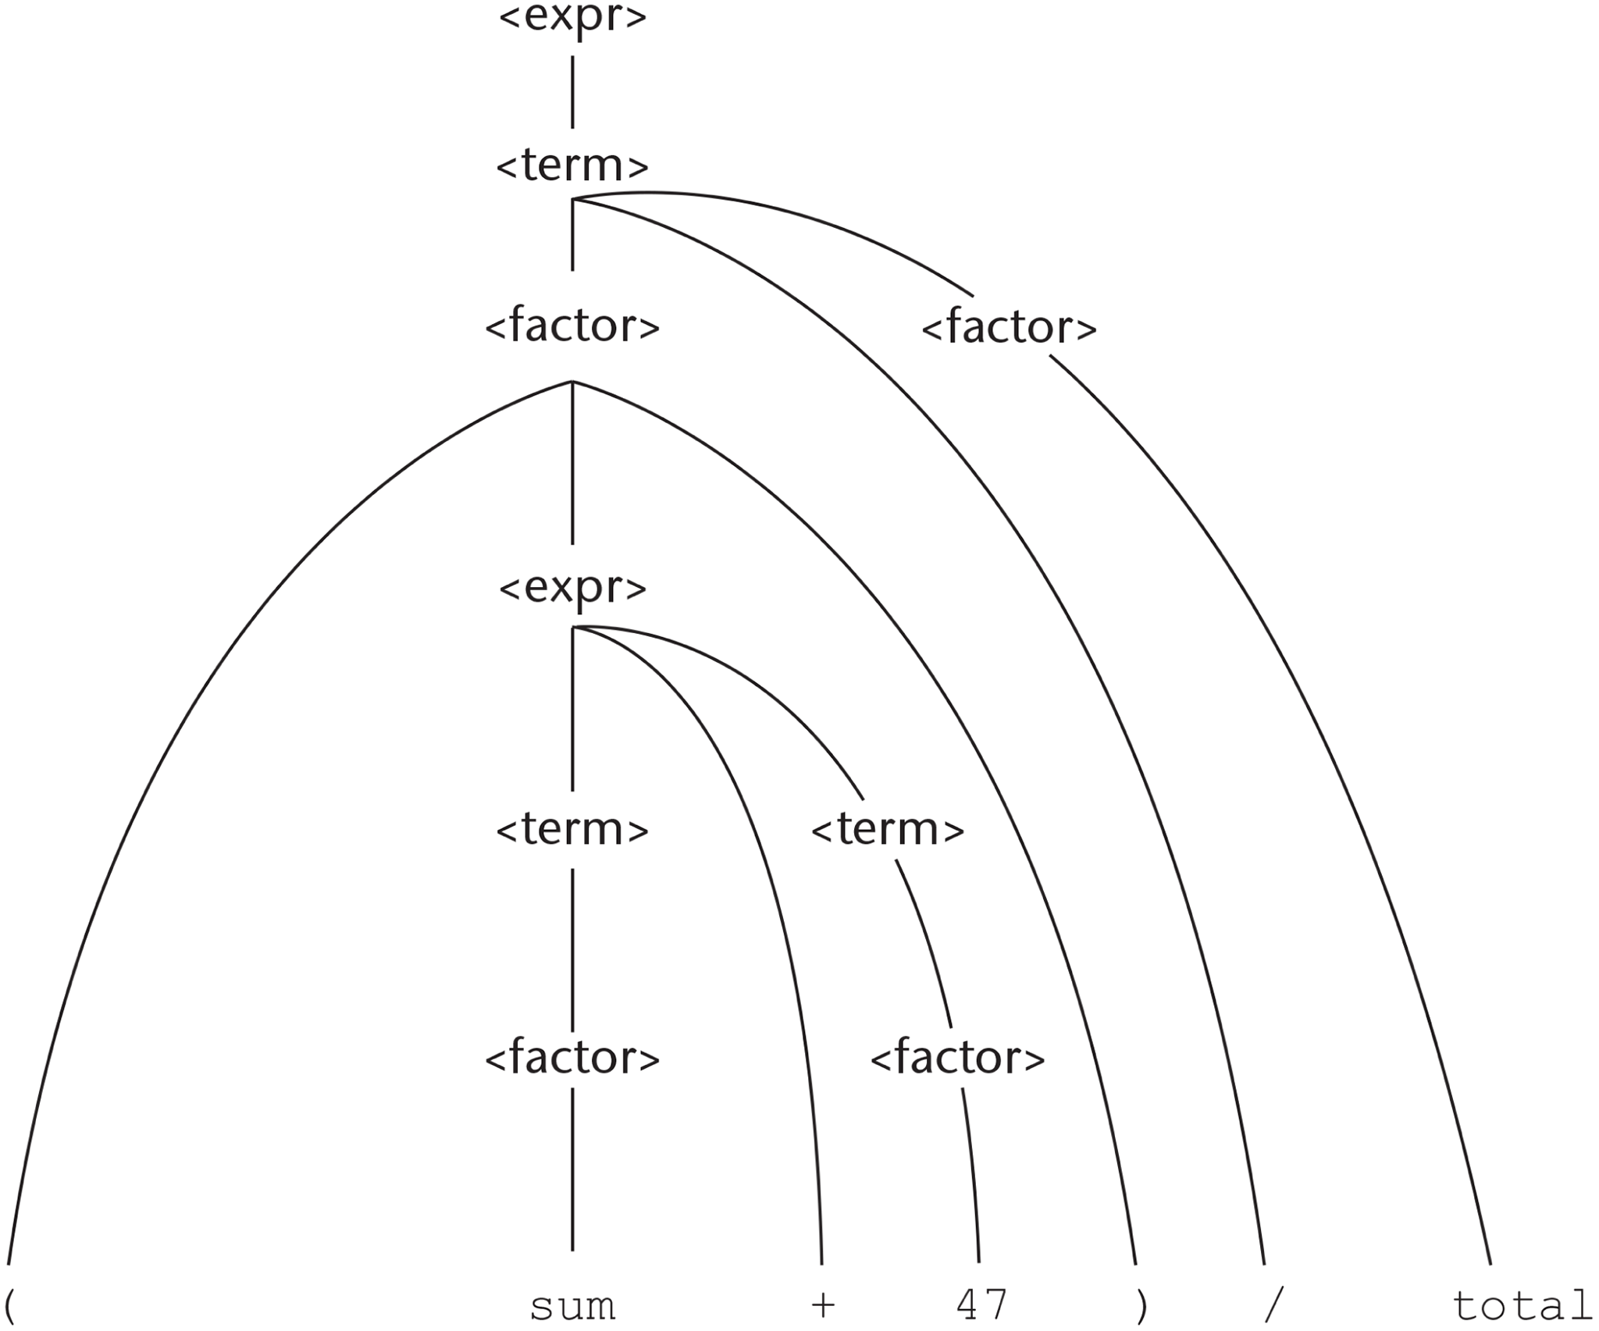
Figure 4-2 Parse tree for (sum + 47)/ total

Slide 4
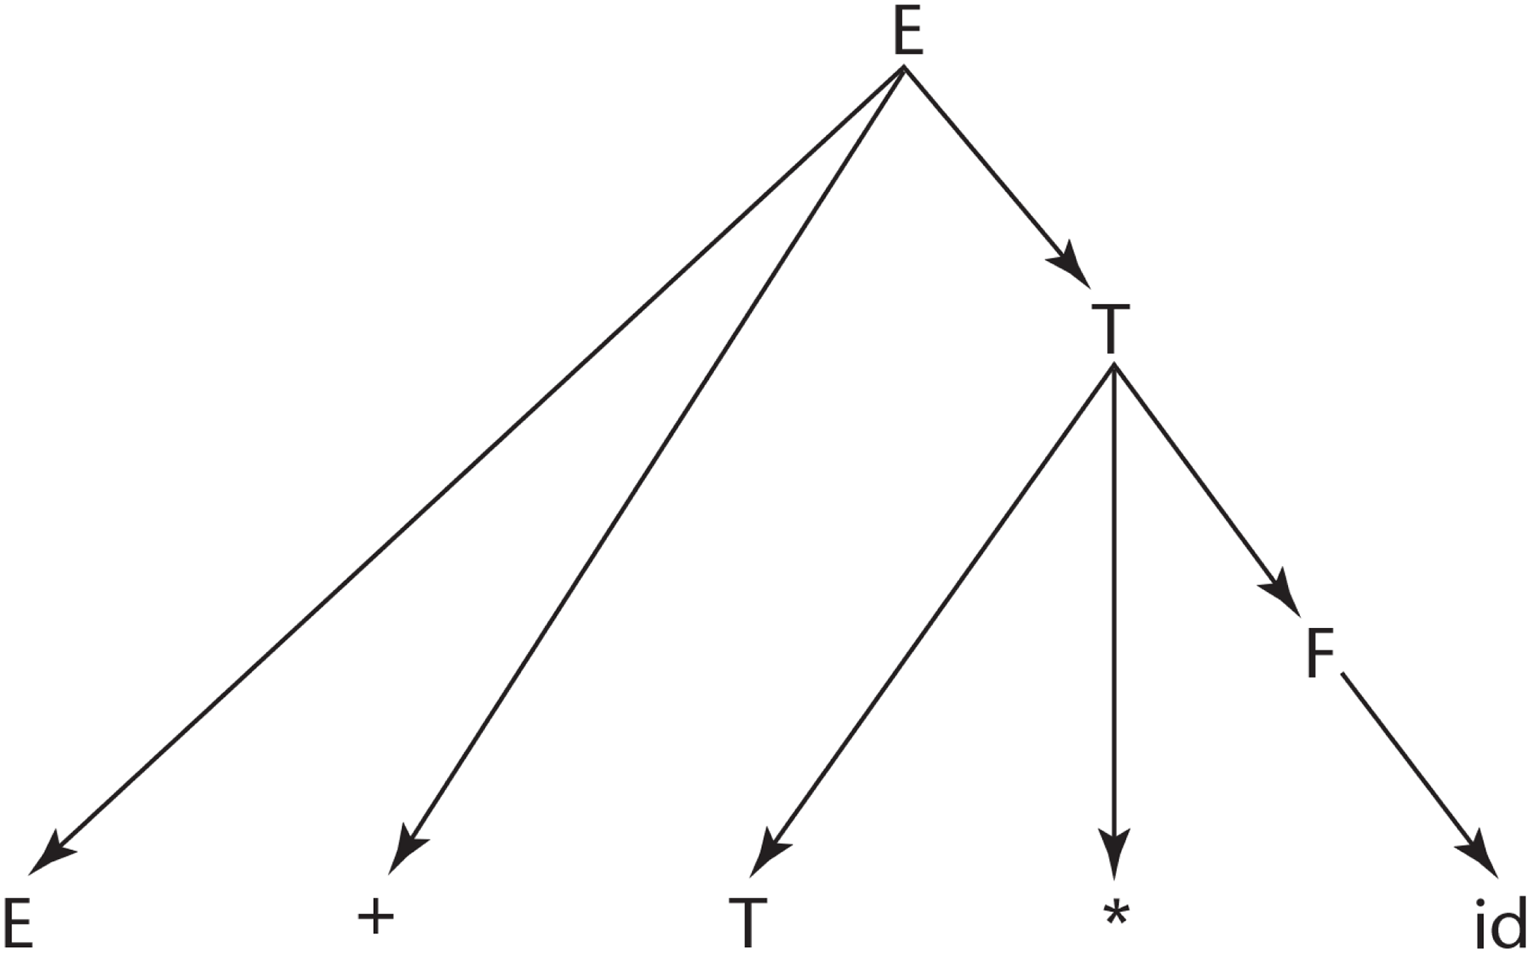
Figure 4-3 A parse tree for E + T * id

Slide 5
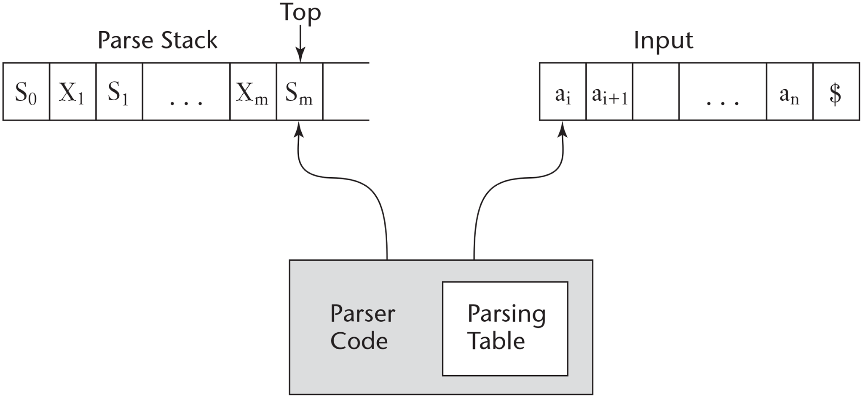
Figure 4-4 The structure of an LR parser

Slide 6
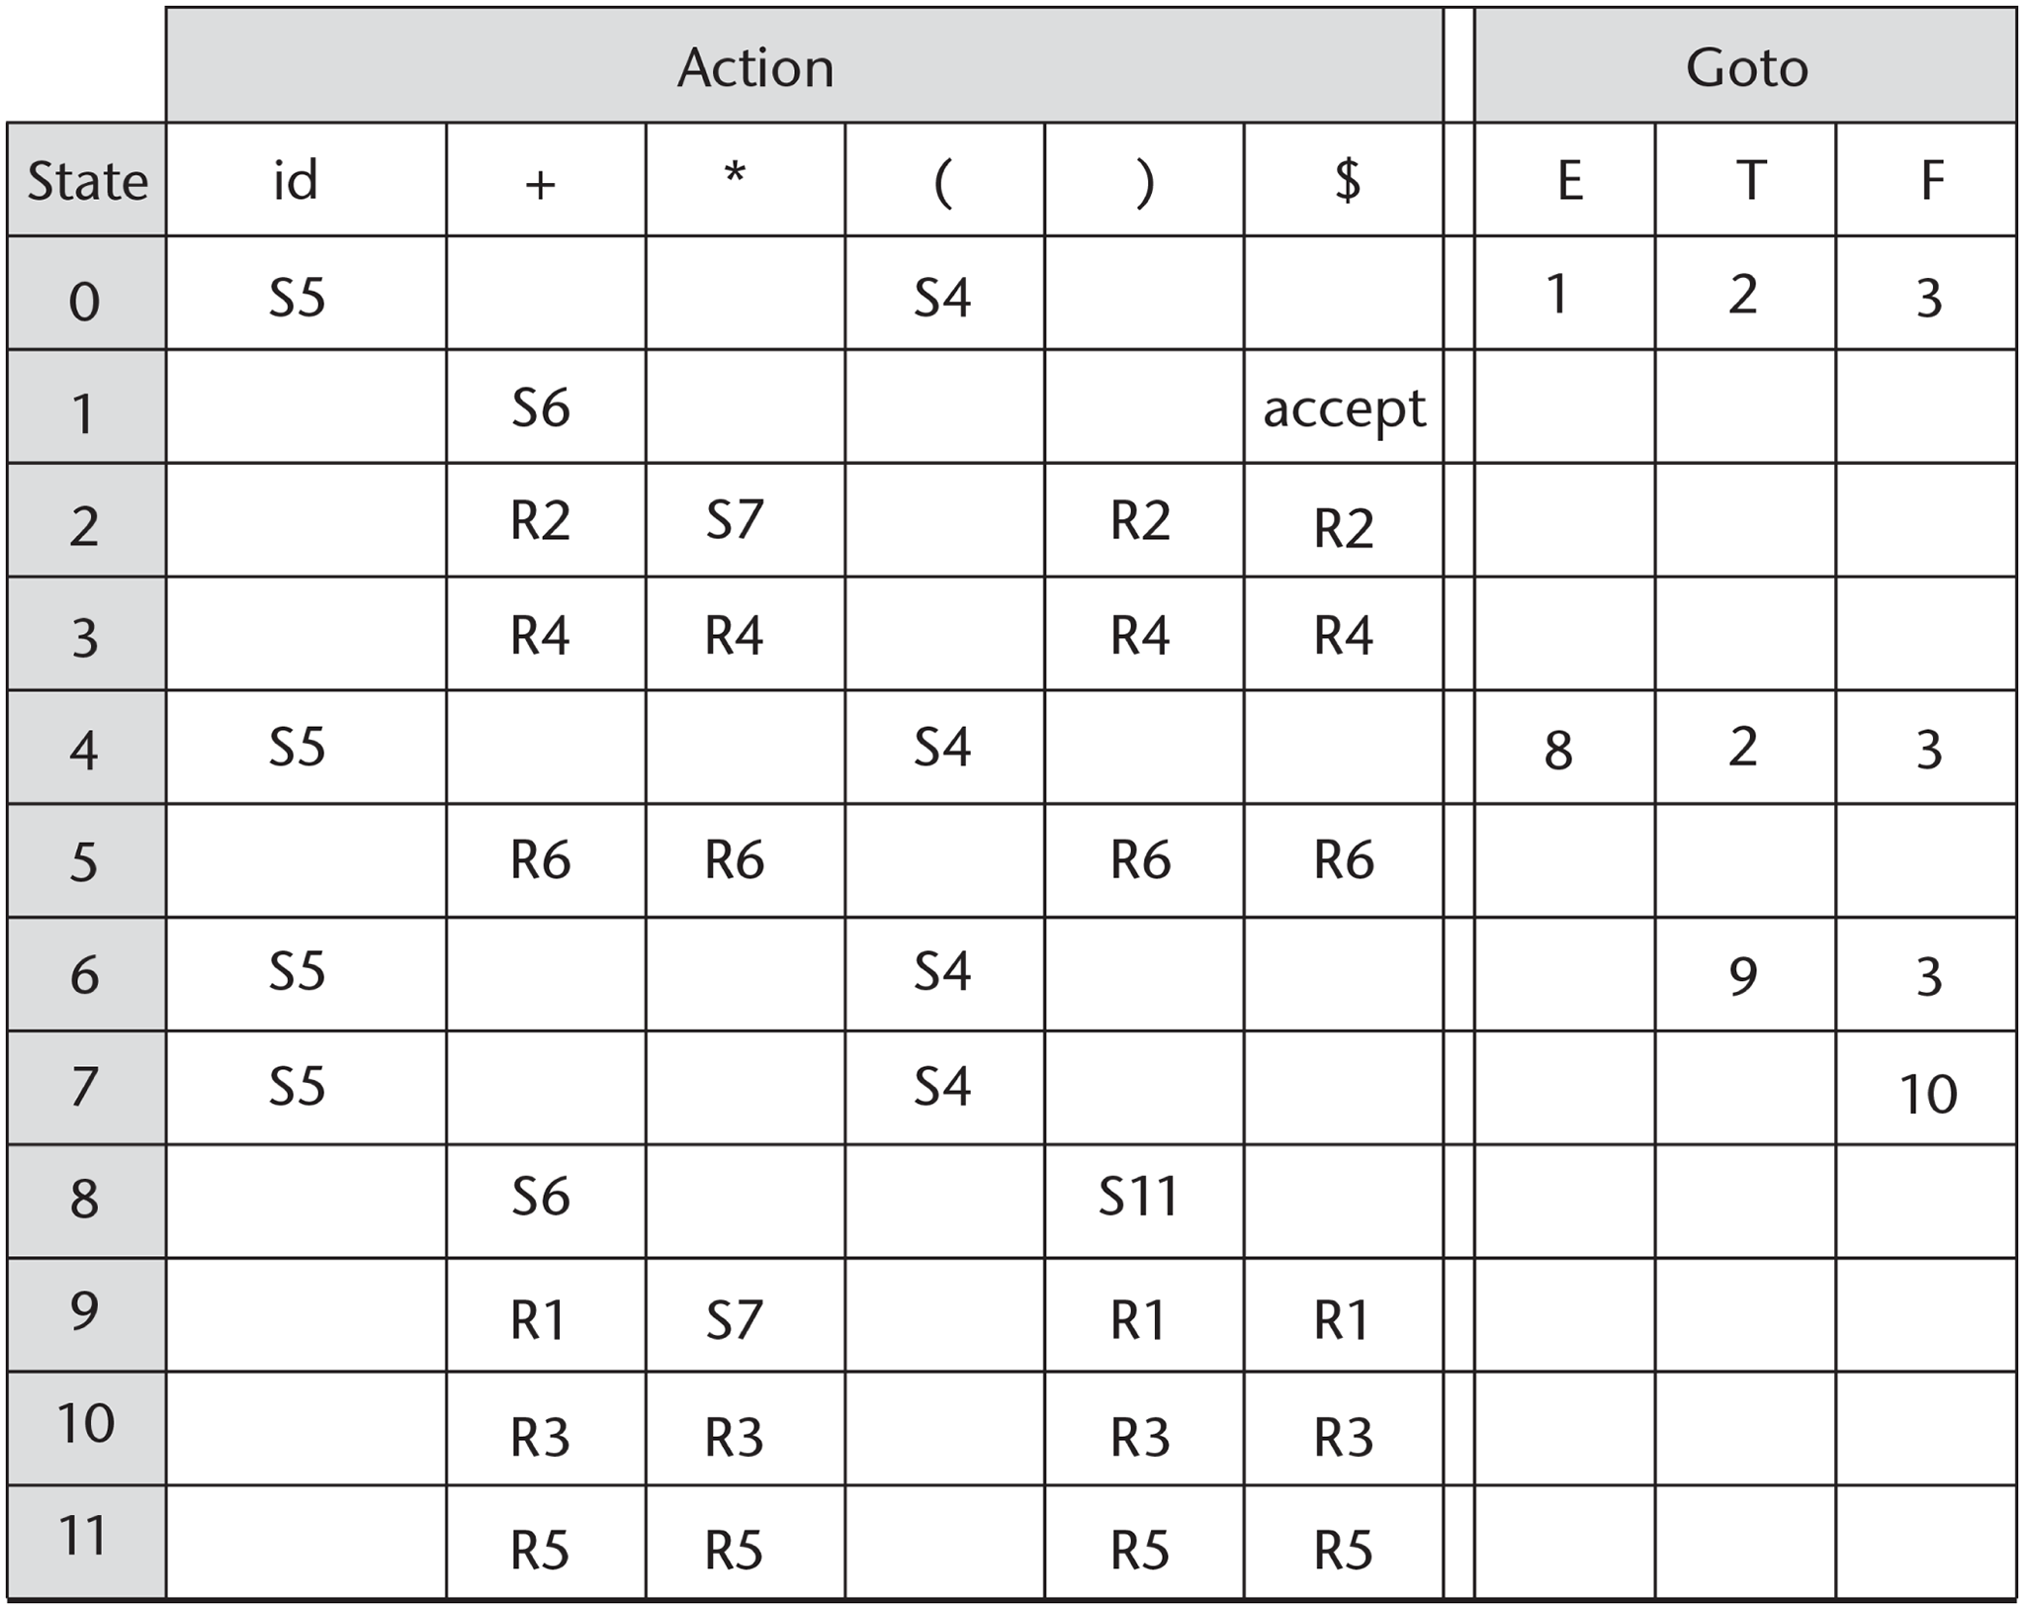
Figure 4-5 The LR parsing table for an arithmetic expression grammar

